Slide 1
AUTOMATIC IRRIGATION SYSTEM
Yarrarapu Chaitanya Sundar Jose
[CH.EN.U4CYS21095]

Slide 2
Problem Statement
In many households and agricultural settings, maintaining consistent and appropriate watering for plants can be challenging.
Factors such as varying weather conditions, human oversight, and busy schedules contribute to inadequate or excessive watering, leading to suboptimal plant growth and health.
This inconsistency in watering can result in plant stress, stunted growth, or even plant mortality.

Slide 3
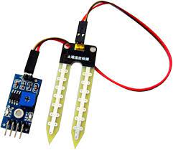
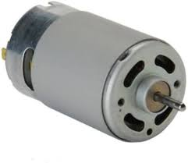
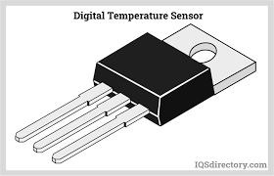
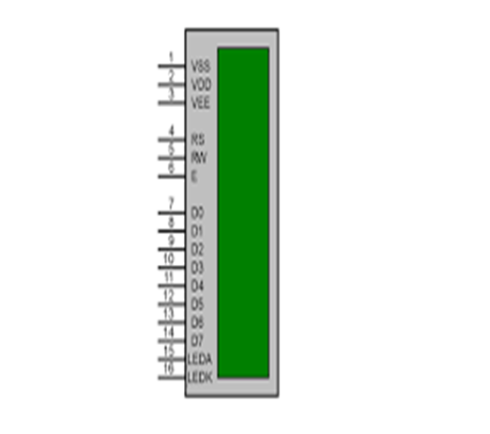
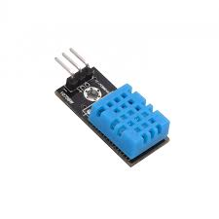
Solution

Slide 4
Problem Identification
Overwatering or Underwatering:
Problem: Incorrect sensor calibration or faulty sensors can lead to overwatering or underwatering of plants.
Sensor Malfunction:
Problem: Sensors may degrade over time, leading to inaccurate readings or no readings at all.
Power Supply Issues:
Problem: Power interruptions or low battery levels can disrupt the system's functionality.
Clogging of Water Delivery System:
Problem: Water nozzles or tubes may get clogged due to debris or mineral deposits.

Slide 5
Problem Identification
5. Leakage:
Problem: Faulty connections or damaged tubing can lead to water leakage.
6. Inadequate Water Pressure:
Problem: Insufficient water pressure can result in uneven watering or failure to reach all plants.
7. Environmental Interference:
Problem: Environmental factors such as extreme temperatures or humidity may affect sensor accuracy.

Slide 6
Solution
Regularly calibrate or replace sensors, and adjust watering parameters based on plant needs.
Regularly test and calibrate sensors, and replace them if they are no longer providing accurate data.
Ensure a reliable power source, use backup batteries, and implement low battery alerts or a power backup system.
Regularly inspect and clean water delivery components to prevent clogging.

Slide 7
Solution
Inspect all connections regularly, and replace damaged components promptly.
Check and maintain adequate water pressure, and adjust the system to ensure even distribution.
Implement protective measures or shields for sensors to mitigate the impact of environmental factors.

Slide 8
DC Motor
A DC motor is an electrical motor that uses direct current (DC) to produce mechanical force.
The use of a DC (Direct Current) motor in an automatic plant watering system is common for controlling the water flow to plants.
The use of a DC motor in an automatic plant watering system provides a versatile and efficient means of controlling water flow, allowing for precise customization based on plant needs, user preferences, and environmental conditions.

Slide 9
Soil Moisture Sensor
Soil moisture sensors measure the volumetric water content in soil.
The relation between the measured property and soil moisture must be calibrated and may vary depending on environmental factors such as soil type, temperature, or electric conductivity.
Soil moisture sensors typically refer to sensors that estimate volumetric water content.

Slide 10
LCD Display
LCD's are generally used as a display in many applications as they are easy to use then seven segment displays. 16*2 LCD are alphanumeric LCD's which can display alphabets, numbers and some special characters. They are easily operated using commands which are hexadecimal values.
POT-HG is the only active variable resistor that allows you to change the resistance during simulation run-time.
Virtual Terminal is a tool in Proteus, which is used to view data coming from Serial Port (DB9) and also used to send the data to Serial Port.

Slide 11
Temperature Sensor[LM35]
1. Temperature-based Watering:
The LM35 can be placed in close proximity to the plants to measure the ambient temperature. Different plants may have varying water requirements based on temperature sensitivity.
Implement logic in the system to adjust watering schedules based on temperature data. For example, during hotter periods, the system may increase the frequency or duration of watering to compensate for higher evaporation rates.
2. Preventing Overwatering in Cold Conditions:
In colder conditions, plants may require less water due to reduced evaporation. The temperature data from the LM35 can be used to reduce watering during colder periods, preventing overwatering and potential root rot.
3. Customizing Watering Parameters:
Integrate the LM35 temperature data into the system's user interface. Users can have the option to customize watering parameters based on temperature preferences for specific plants.
For instance, some plants may thrive in slightly cooler or warmer conditions, and users can set temperature thresholds to tailor the watering schedule accordingly.
4. Energy Efficiency:
Leverage the LM35 data to implement energy-efficient features. During periods of extreme temperatures, the system can enter a low-power mode to conserve energy when watering demands are likely to be minimal.

Slide 12
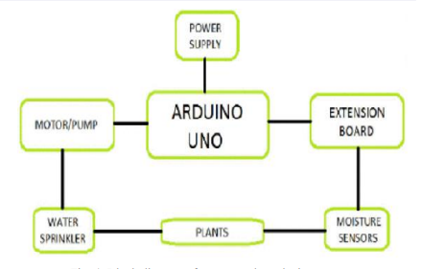
Block Diagram

Slide 13
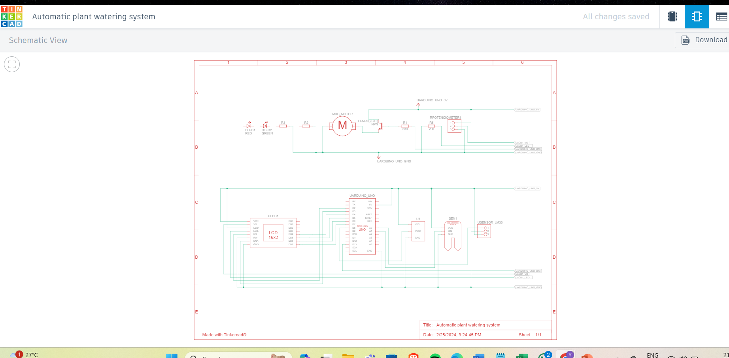
Schematic Diagram

Slide 14
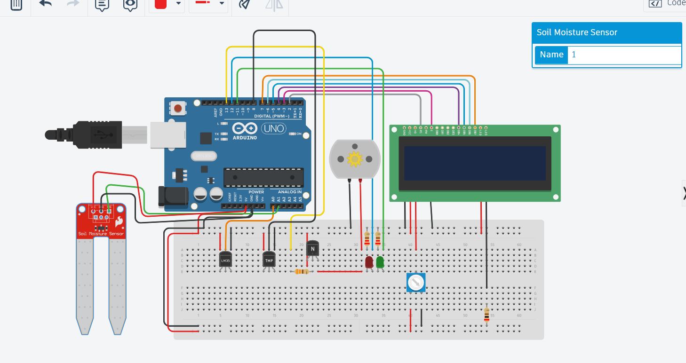
Implementation in TinkerCad

Slide 15
Hardware Components
Arduino Uno
DC Motor
16×2 LCD Display
Soil moisture sensor
Humidity sensor
NPN Transistor(BJT)
220 ohm Resistor *2
LED Green
Potentiometer 10k
LED Red
330 ohm Resistor
200 ohm Resistor
Temperature Sensor[LM 35]

Slide 16
Thank You!

